Slide 1
TRANSACTIONS PART 1 - ATOMICITY

Slide 2
AGENDA
What are transactions?
Why do we need them?
ACID
Atomicity

Slide 3
Rationale behind transactions
Imagine a scenario where you pay someone from your bank account. Something goes wrong during the payment process and the payment does not go through. HOWEVER, the EFT fee that the bank usually charges is debited from your account.....
Without DB transactions, the above scenario would be a very real possibility.

Slide 4
What are transactions?
A set of operations that must succeed or fail as a single unit.
All operations ALWAYS run in a transactional context.
By default, transactions contain a single DB operation.
We can issue commands to the DBMS to begin or end transactions.
This allows us to group operations into a single atomic unit.

Slide 5
ACID
The SQL Standard specifies 4 properties that Database transactions must have.
These are famously known by the acronym ACID.
Atomicity – All or nothing. This is apparent from the definition of transactions.
Consistency – Transactions must not violate any of the DB constraints.
Isolation – Concurrent transactions must not interfere with the current transaction.
Durability – Completed transactions endure even through failure. (Robustness)
We will focus on atomicity and isolation.

Slide 6
Atomicity
To achieve atomicity we need the ability to define a transaction as well as control the rollback of a transaction.
If all operations succeed all changes materialise and become durable.
If a single operation fails, all prior changes in the transactional context are undone and the DB is restored to the state it was at before the transaction commenced.
Every DBMS has its own way of enacting rollback.
Demos

Slide 7
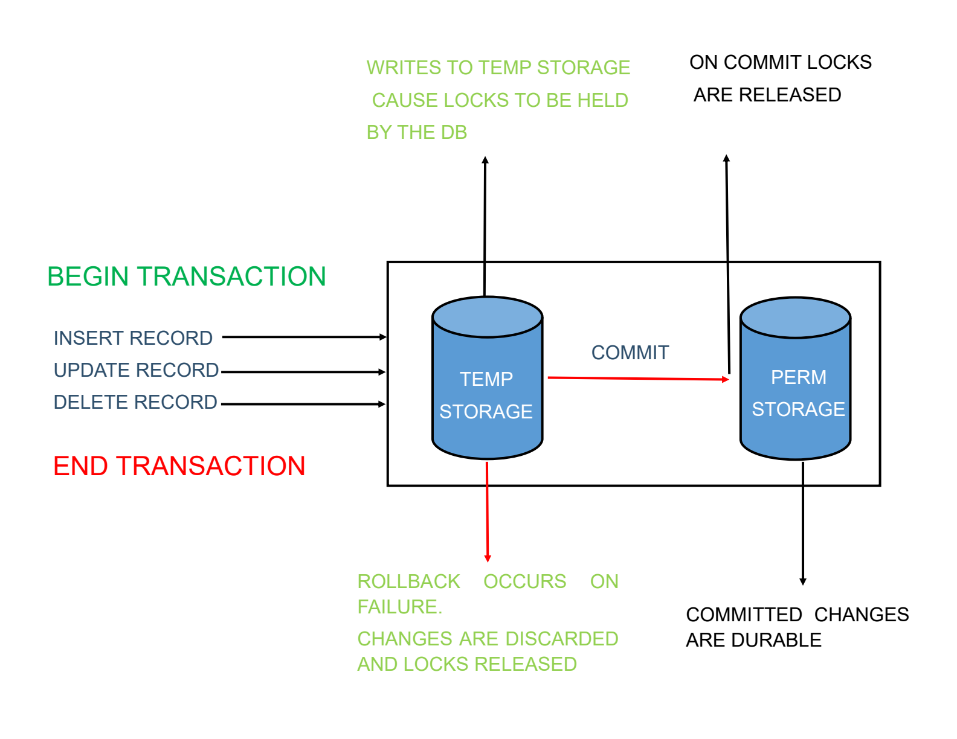
Atomicity

Slide 8
Read-Only Transactions
Some DBMS providers provide for read-only transactions.
This allows the DBMS to apply some optimisations.
Where this is supported by a DBMS, trying a modifying statement in a read-only query will result in an error.
JDBC Connection class has a method to set readOnly flag. This is considered a hint, as some DBMS providers don’t support this. In that case, the setting will have no effect.
This setting cannot be changed during a transaction.

Slide 9
Homework
Read up more on the other two ACID characteristics: Consistency and Durability.

